Slide 1
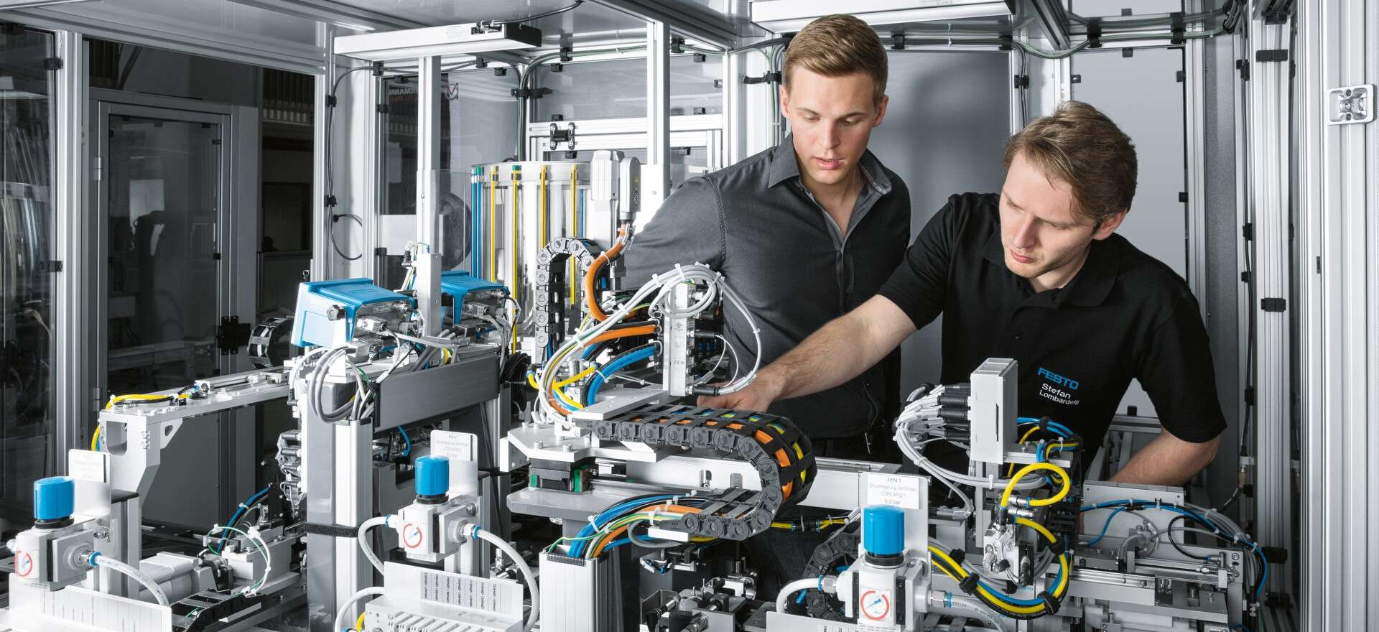

FESTO Project
Group S
Luca Santoro 0001005415
Armando Spennato 0001006172
Riccardo Bassi 0001084538
Notes:
With these slides we want to present the FESTO project , which is an assembly line, used to assemble a finite product composed by a body, a piston ,a spring and a cap. The finite product can have the body red, black or silver. If the body is black the corresponding piston will be silver otherwise black

Slide 2
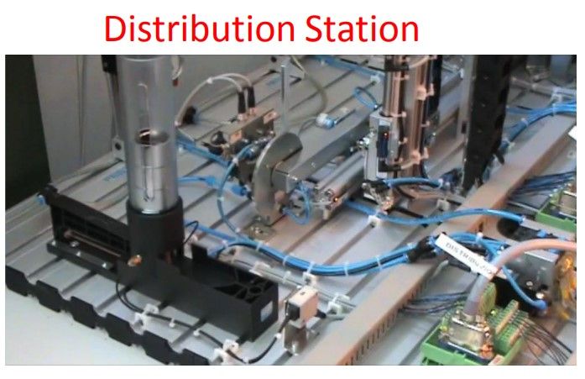
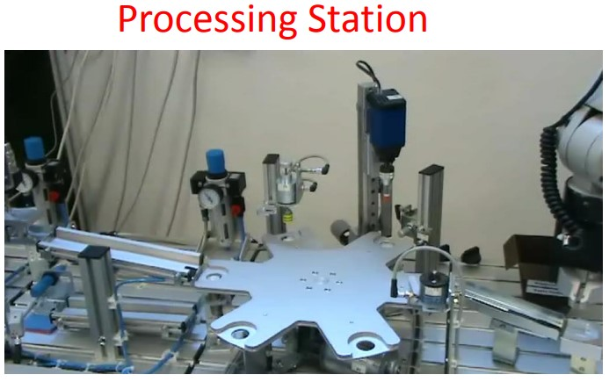
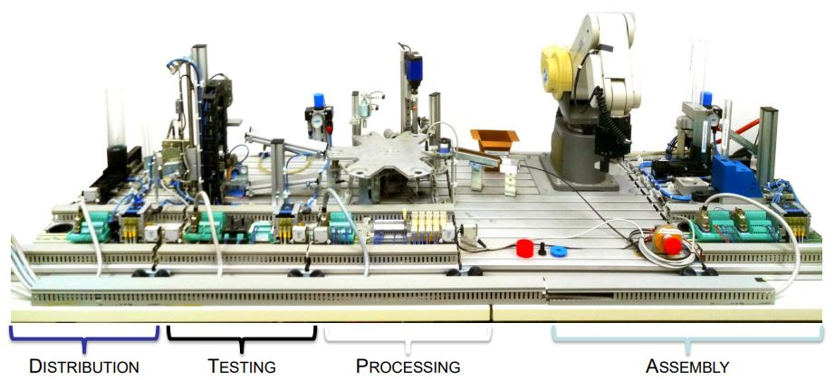
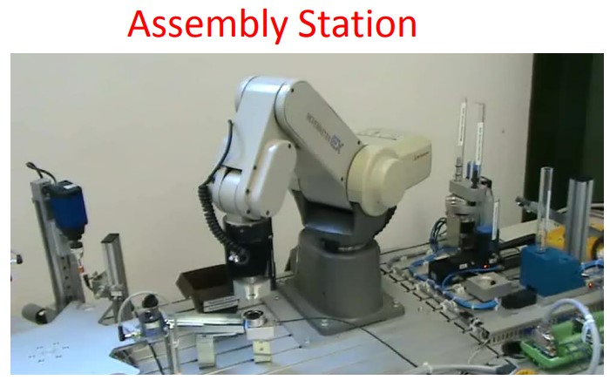
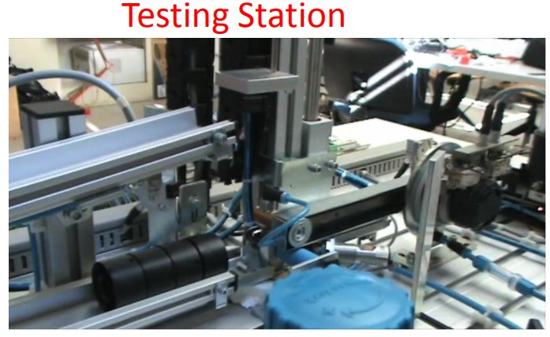
FESTO ASSEMBLY LINE
Notes:
The assembly line is composed by four different stations: DISTRIBUTION SECTION --> In which the body is taken from the warehouse and distributed to the testing station; the TESTING STATION --> in which there are different sensors to verify the presence and mesure the height of the object, if the height is not correct the part is discarded; PTOCESSING STATION --> After the various tests the piece arrives on a rotary table where is drilled by a drill; finally we have the ASSEMBLY LINE --> in which a robot assembles all the parts of the finite product and discardes the wrong products.

Slide 3
PROJECT STRUCTURE
HARDWARE
Input Bridge
Output Bridge
Generic device
Generic device
Station 1: Distribution Station
Station 2: Testing Station
Station 3:
Processing Station
Station 4: Assembly station
Generic device
Generic device
Main Program
Signal Management
…
Notes:
The project is structured in this way , we define first the generic device function block , which is encharge to activate/deactivate all devices of line. Then we design the different stations function block connected to the hardware throught the input and the output bridge. Then we have defined the signal menagement function block to give informations how what is happening on the machine. Then the main program allows us to connect all the function blocks. (it is a program not a function block)

Slide 4
FINITE STATE MACHINE - STATION
READY TO RESET
INIT
MAIN FSM
READY
EMERGENCY STOP
RUN
ON PHASE STOP
IMMEDIATE STOP
Notes:
Each station has the same structure of the following finite state machine. Naturally, for each station,all the operations implemented in these states are different. The state are explained on the following slide.

Slide 5
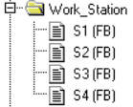
NOMINAL BEHAVIOUR - STATION
Pre-set inizialization (not for rotary table)
Set if the stations are stopped in safe conditions
INIT
IMMEDIATE STOP
InitializzationDone
ActivateVacuum, ActivateAir
Stop after movement done (always safe conditions)
Idle state
READY
ON PHASE STOP
Working operation sequence with FSM
Reset variables
RUN
RESET
Go
Notes:
In the INIT state all the device and variables are initialized and the relative station goes into the ready state, and it is ready to RUN and perform all the operations. Each station can be stopped by two kind of stop: 1) IMMEDIATE STOP --> We stop the machine immediately also if it is doing something importat. After this action, if we want to restart the machine we have to check if the machine is in a good state to be restarted.
2) ON PHASE STOP --> Allows to stop the activity of the machine in controllable way and in a state confortable for the machine to restart.
RESET --> there are 3 type of resets, to reset all allarms and variables. In particular we have the AUTO CONDITIONED reset -> Were the machine automatically reset itself when some conditions are met. AUX reset (key reset) -> which is a reset that requires a key to be activated, for this reason the machine can be resected only by tecnichian. Then the AUTO - PROVISIONAL reset --> Which is a reset that doesn't remove the allarm but remove the output. So the allarm is still present but it doesn't generate any reaction in the machine.

Slide 6
LIBRARIES
FUNCTION BLOCKS
FUNCTIONS AND PROGRAMS
GenericDevice.FB
SignalManagement.FB
Filter.FB
FaultSim.FUN
PriorityCodeToString.FUN
ClocksGeneration.PRG
Notes:
In this slide we can see all the libraries that we have implemented and that can be used for all types of machines.

Slide 7
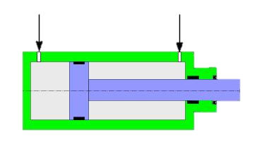
GENERIC DEVICE
DISABLED
STATE
ENABLE PHASE STATE
Device Sensor Enabled
Device Sensor Disabled
Device Enable Request
Device Disable Request
HARDWARE
DISABLE PHASE STATE
ENABLED STATE
Device Actuation Enable
Device Actuation Disable
Device Faults
GENERIC DEVICE
Notes:
the generic device is structured in this way: when there is a request from an external device the enable device signal is set to true and so we have a transition in the enable phase state, in which we wait the activation of the device. Then we can move into the enabled state. When there is a disable request from an external device to disable the device the same mechanism is used.

Slide 8
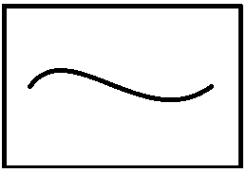
FAULT DETECTION
Device Type
Actuation Device
Detection Fault
Feedback Device
Fault Signals
Avoid Fake Faults
FILTER
Notes:
The fault detection is based on the device type, in particular we distinguish Actuation device and feedback device. Then to avoid fake detection we exploit the activation delay to filter the fault signals

Slide 9
SIGNAL POLICIES
Time
Signal Priorities
HIGH
LOW
Signal Code
Alarms
0 - 70
Anomalies
71 - 130
Warnings
131 - 190
Informations
191 – 256
Actuation Fault
IMMEDIATE STOP
Warnings
Auto - Reset
Informations
Feedback Fault
ON PHASE STOP
Notes:
The signal priorities are dynamically assigned by time and statically by signal code. In particular lower is the value of the code higher is the priority of the signal. The Auto - Reset is used for warnings and the informations signals. Then when there is an Actuation Fault an immediate stop occurs and when there is an Actuation Fault an on phase stop is implemented.

Slide 10
SIGNAL MANAGEMENT
Station1
Signals
SignalType
SignalCode
SignalOutput
ActivationSignal
AutoResetSignal
GUI HMI
Emergencies
Protections
Faults
Station2
Station3
Station4
START CONFIGURATION
INIT
CONFIGURATION
MAIN FSM
ON PHASE STOP
GENERATION
RUN
START GENERATION
IMMEDIATE STOP
EMERGENCY STOP
SIGNAL MENAGEMENT
Notes:
As we mentioned before the signal management function block is used to obtain informations of what is happening in our assembly line. In particular in this function block we manage all the combination of signals taking into account all the reset conditions, stop conditions, the operation modes of the machine and all the usefull informations of the machine for the user, such as emergencies, protection faults ecc...
To do this we store for each signal the all configuration in the signal type variable then we need also the signalCode which is also the priority of the signal and the signalOutput which is the reaction that the machine can have to react to the signal. Finally we need also two other variables that are activationSignal (the signal that we want to activate) and the autoresetsignal.
To implement the signal management we have 4 phase. The STAR CONFIGURATION phase in which we reset all the signal counts. In the CONFIGURATION fase we call the function block according to the signal type and we increase the counters of the various signals., to know how many signals of each category we have.Then in the START GENERATION phase we reset all the dynamic informations. Then we have the GENERATION PHASE in which again we call all the blocks, all the configurations of the signals, we evaaluate the signaltypye and we increase again the relative counter.

Slide 11
MACHINE POLICIES
At least one piece available
Start machine condition
Empty machine
Emergency state
Key - Reset
Reset/Initialize conditions
When inactivity timer expires
Automatic On-Phase Stop
No active faults
Notes:
Regarding the machine policies the first aspect is that to start the machine we need at least one piece available while to reset and initialize the machine we need no active fault and an empty machine.
Then, when the machine is in the Emergency state we need a key reset to restart. While when the inactivity timer expires there is an automatic on phase stop. This stop is managed as a signal and it is not disabled if we deactivate the diagnostic (we can activate and disactivate the dignostic)

Slide 12
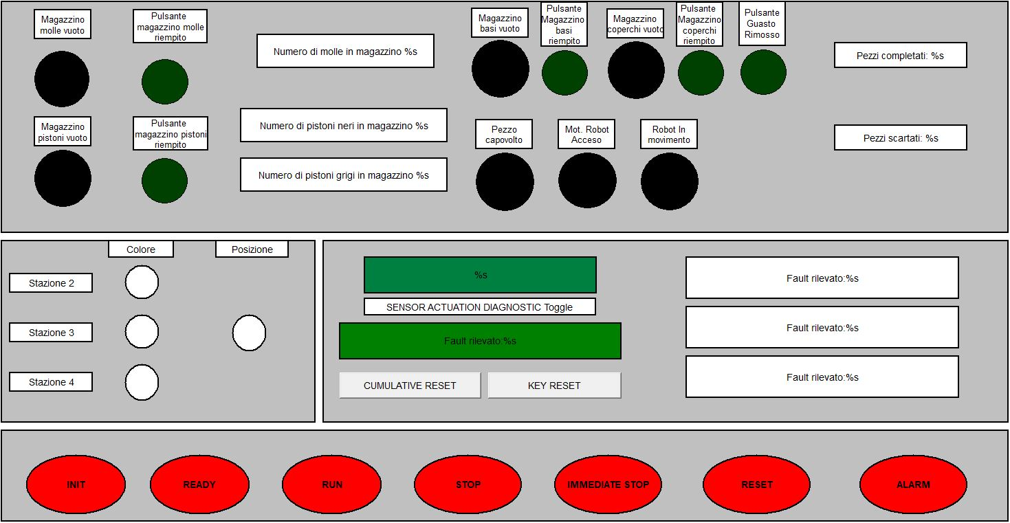
VIRTUAL PANEL
Notes:
In this slide we can see the Virtual Panel, so the HMI with which the user can interface itself with the machine. In particular the user can see the current state of the machine, the relevant informations, alarms, the actual fault and a fault History. Finally there are also various leds and displays to give other user useful informations about the machine such as the position of the pieces among the stations, the configuration and the whareouses availability, but also the number of completed pieces and discarded pieces.

Slide 13

SIMULATION VIDEO – 1: GOOD PIECES
Notes:
In this simulation the assembly line machine produces only good final products (so no wrong products)

Slide 14

SIMULATION VIDEO – 2: NO GOOD PIECES
Notes:
In this simulation, instead, the assembly line machine discards wrong pieces. The bodies with short height are discarded in the second station while the pieces that are not assembled correctly are discarded by the robot arm in the assembly station.

Slide 15
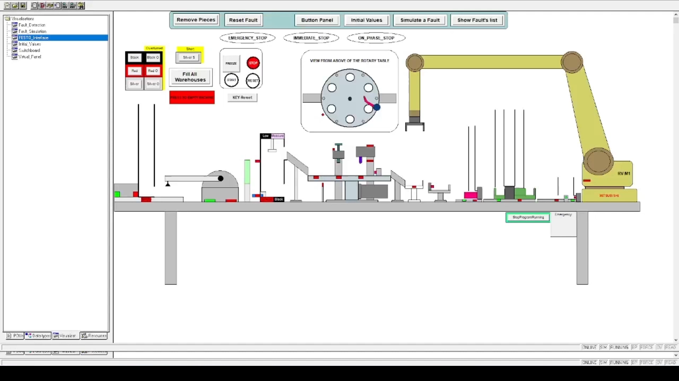
SIMULATION VIDEO – 3: FAULTS

Slide 16
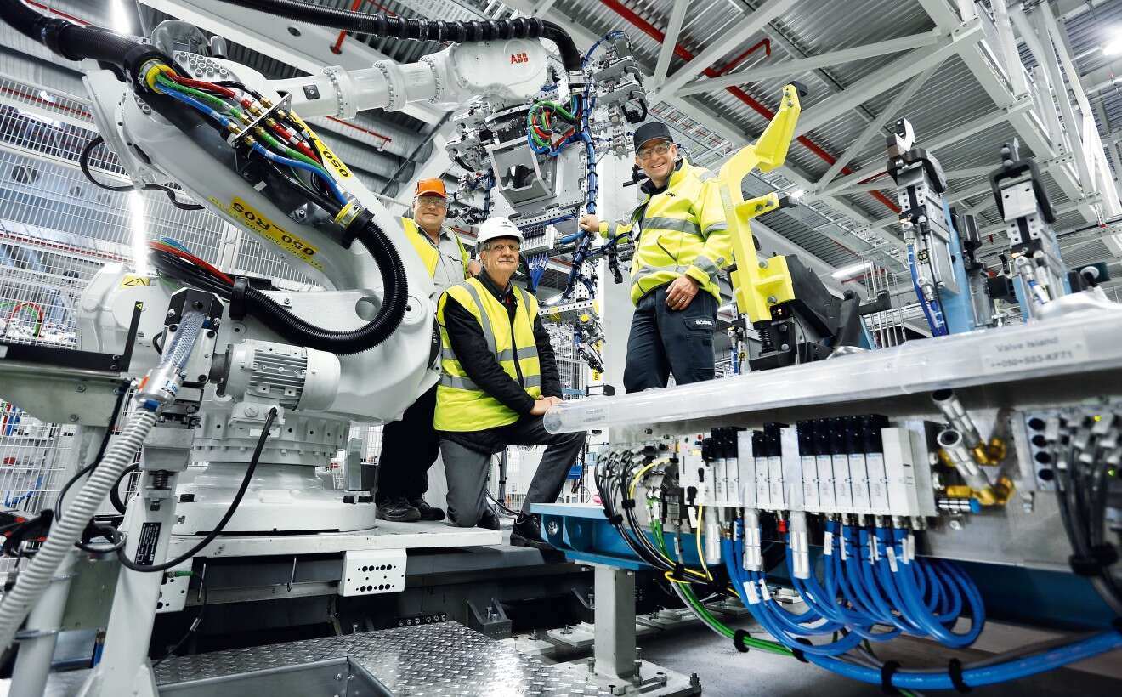
Thank You For Your Attention

